Slide 1
Test Automation
Presented by: Alex Reel, Patrick Yoder, and Benjamin Ellis
Team 7 - Cloud 9

Slide 2

Project Overview
Customer - Ben Fox - Trissential
Trissential - Software Quality Assurance
Needs
Functionality and appearance improvements
Additional bugs for more diverse debugging
Why?
Employee training and testing
Demonstration Services to current and potential clients
Providing a more modern, realistic feel to improve performance

Slide 3
Presentation Overview
Architecture
Web Interface, Database Layer, Web Server, Email Relay
Methods
Implementation
GUI, WishList, Database, Bug Testing
Testing
Metrics

Slide 4
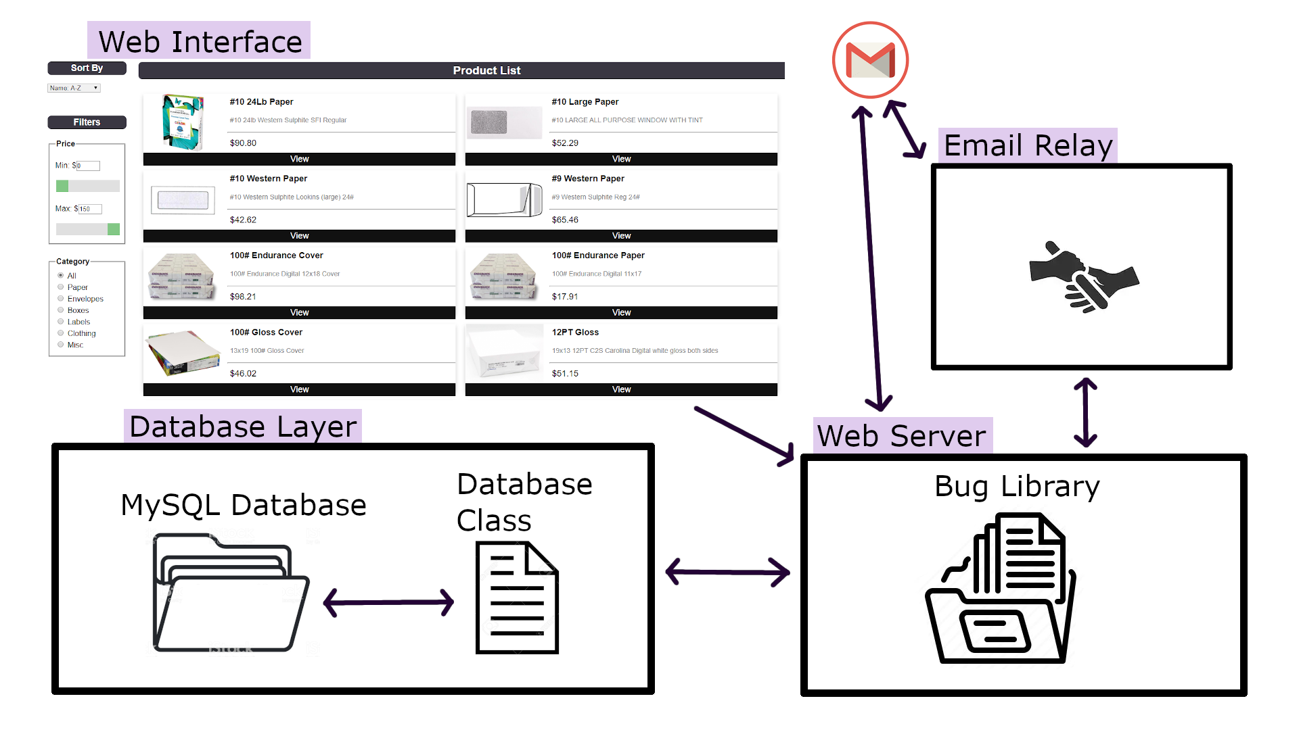
Architecture

Slide 5
Methods for the Storefront
Registration/Login
Search/Filter
Product list display
Database
Order history
Cart
Checkout
Admin functionality
Bug framework
Wishlists
Store administrator user
Store-wide discounts

Slide 6
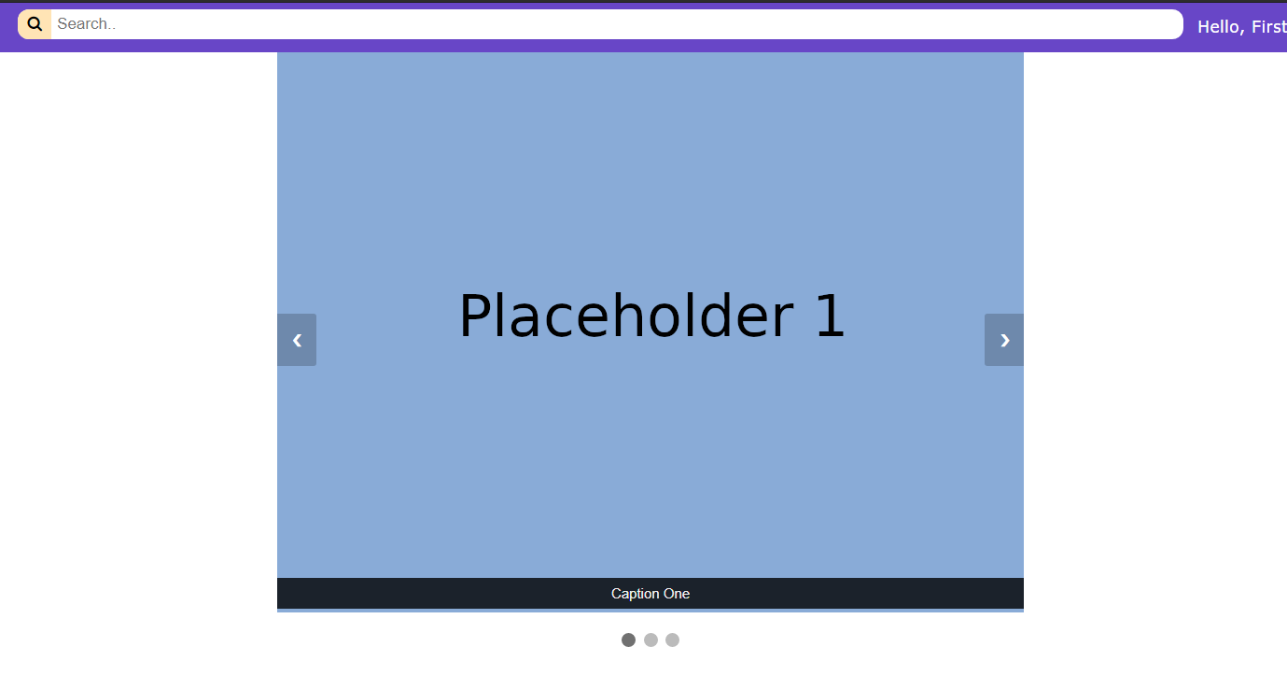
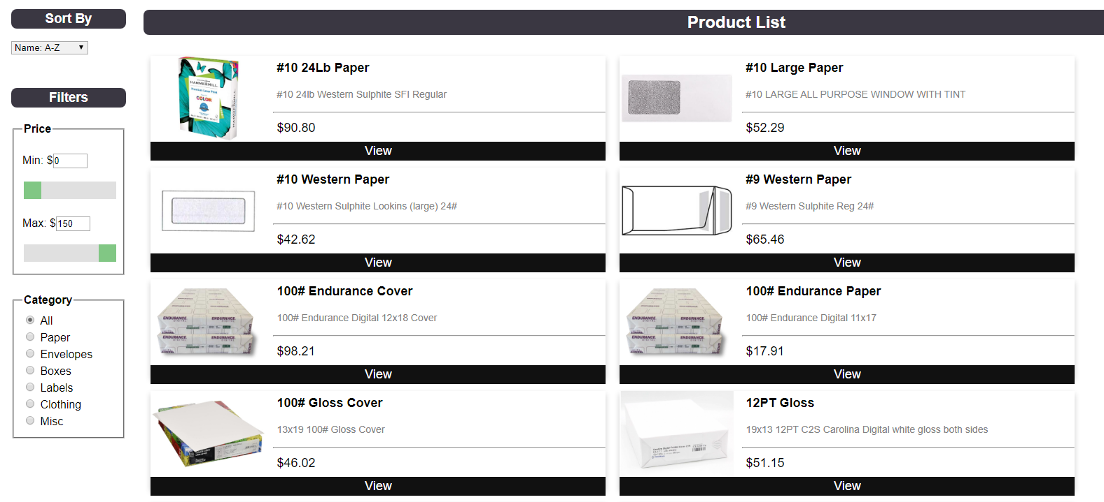
Implementation - GUI
Home Page
New Product List Design

Slide 7
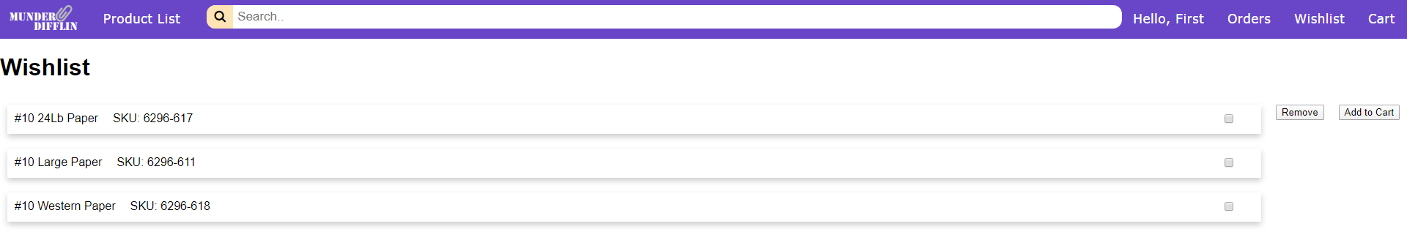
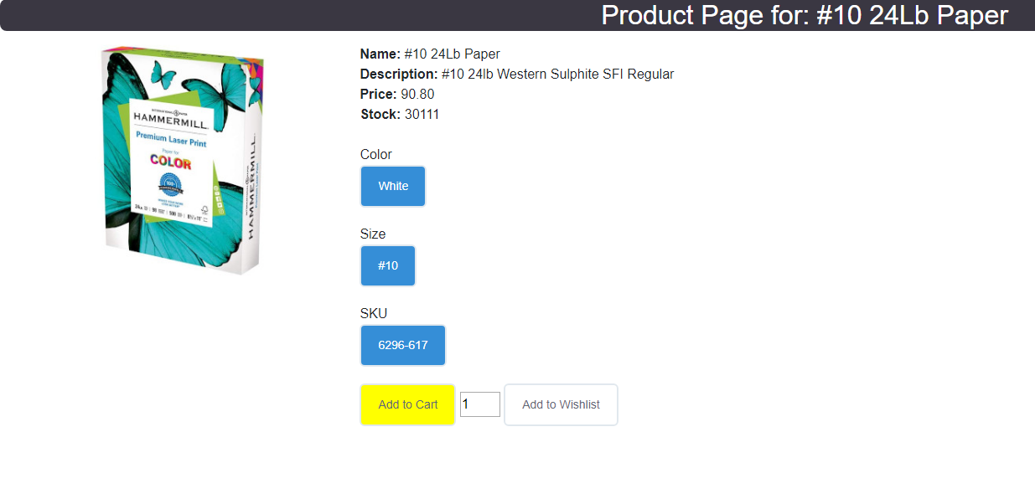
Implementation Cont.
Wishlist Page
Altered Product Pages to Support Wishlist Functionality

Slide 8
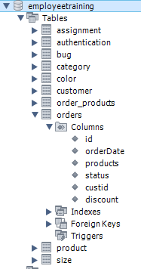
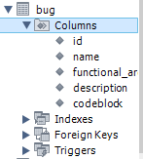
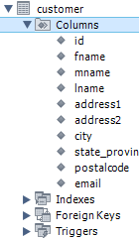
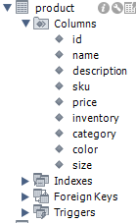
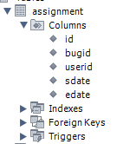
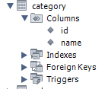
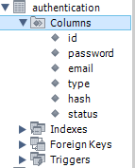
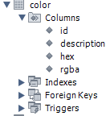
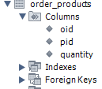
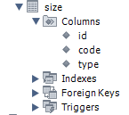
Implementation - Database
The database remained similar to the inherited database with a few changes for our added functionality.

Slide 9
Testing
Decided to focus on manual testing rather than implementing test automation.
Unit tests on the new features were the focus with additional integration tests to ensure proper implementation with existing code.
Testing results were positive overall.
Unfinished elements of product editing was discovered (now fixed).
Checkout form broken (now fixed).
An issue was found that sometimes causes a product to be hidden when it shares a name with an existing product (unresolved).

Slide 10
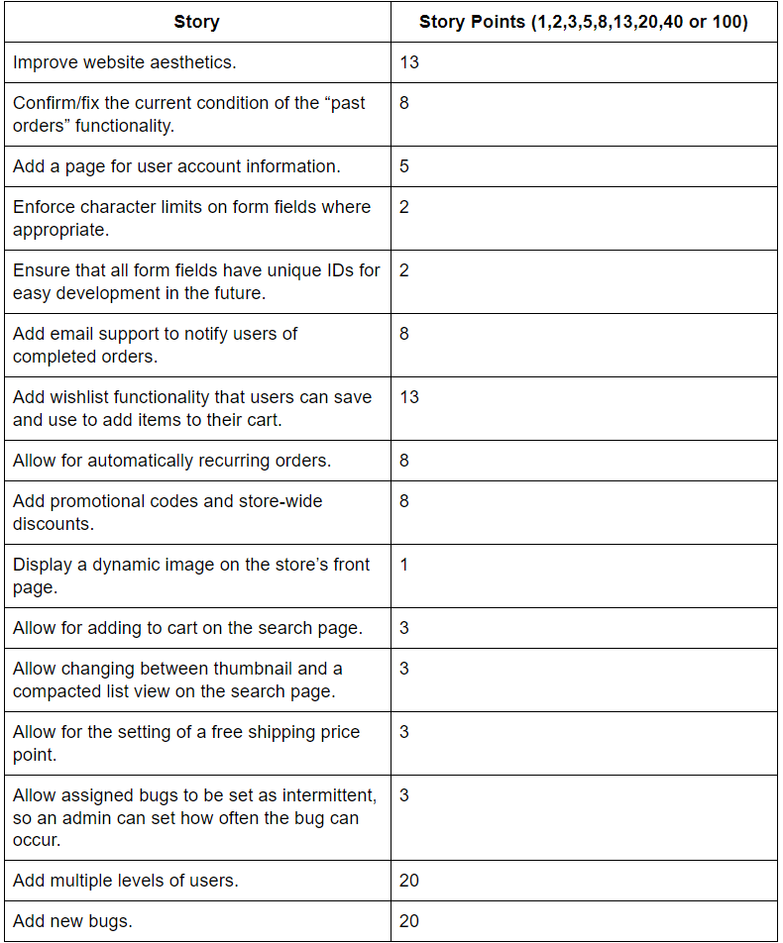
Metrics
These were our initial story point estimations.
After our meeting with the customer, we had a lot of potential user stories to address.

Slide 11
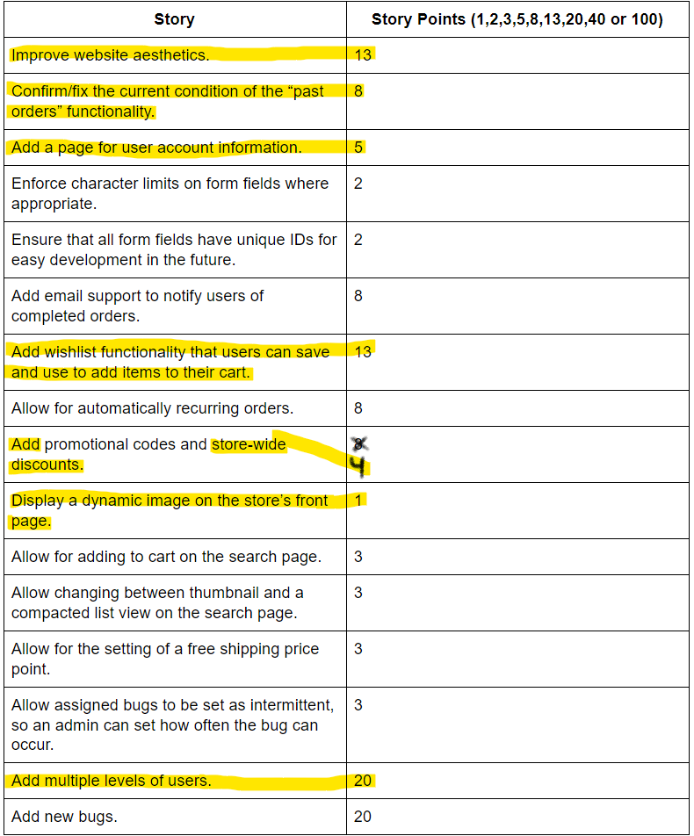
Metrics
Given the global pandemic, we had to scale back the scope of our project and focus on what we could get done based on our changed schedules and work loads.
Highlighted are the user stories we ended up completing.

Slide 12
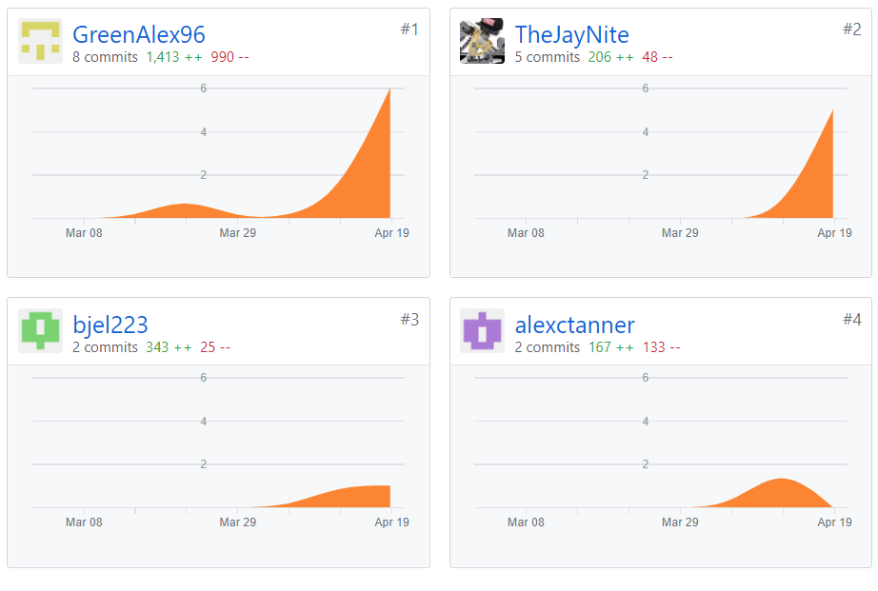
Metrics
Looking at our Github, we have changed 2,129 lines of code with 933 of those lines being brand new code.
(From March 1st to April 21st)

Slide 13
Questions?

